Slide 1




PDS
Computer Vision
Module :
Introduction AWS
https://github.com/siagianp
https://www.youtube.com/@AmelOline/videos
https://github.com/amelcharolinesgn2/Cloud-Infrastructures
https://github.com/amelcharolinesgn2/ClouD-Infrastructure-SISKA-2025
https://github.com/amelcharolinesgn2/CCNA1
https://github.com/amelcharolinesgn2/CCNA2
https://github.com/amelcharolinesgn2/AWS Certificate
Notes:
Lab Session 01: AWS Compute Foundations – EC2, Networking, and Application Deployment Lab Session 02: Identity and Access Control with IAM Lab Session 03: Cloud Storage Solutions – S3, EBS, and EFS Lab Session 04: Database Services – RDS, DynamoDB, and ElastiCache Lab Session 05: Load Balancing and Auto Scaling Lab Session 06: Container Orchestration with ECS, Fargate, and EKS Lab Session 07: Serverless Computing with Lambda Lab Session 08: Monitoring, Logging, and Security Auditing Lab Session 09: Infrastructure as Code – CloudFormation, CDK, and Terraform Lab Session 10: CI/CD Pipelines – App Runner, CodePipeline, GitHub Actions, and CodeDeploy Lab Session 11: AI/ML Services – Rekognition, Comprehend, Translate, and SageMaker Lab Session 12: Hybrid Cloud Networking – VPC Peering, Transit Gateway, VPN, and Direct Connect Lab Session 13: Security and Compliance – AWS Config, GuardDuty, Security Hub, and KMS Lab Session 14: Disaster Recovery and Business Continuity – AWS Backup, Multi-Region, and Failover Lab Session 15: Migration and Modernization – DataSync, DMS, MGN, Containers, and Serverless
Lab Session 16: Cost Management and Optimization – Cost Explorer, Trusted Advisor, Budgets, and Well-Architected
https://www.youtube.com/watch?v=SOTamWNgDKc&t=19604s

Slide 2

This slide is taken
from Amazon
AWS Educate
Introduction to Cloud Computing
https://github.com/siagianp
https://www.youtube.com/@AmelOline/videos
https://github.com/amelcharolinesgn2/Cloud-Infrastructures
Slides are captured from AWS Educate.
This is only for learning tools in Cloud Computing Course
https://github.com/amelcharolinesgn2/ClouD-Infrastructure-SISKA-2025
https://github.com/amelcharolinesgn2/CCNA1
https://github.com/amelcharolinesgn2/CCNA2
https://github.com/amelcharolinesgn2/AWS Certificate
Notes:
PDS

Slide 3
Amel charoline & Irene M
Introduction​
Ec2 Machine
​Storage on AWS
Scalable system
​Deployment
​Security
Price optimization

Slide 4
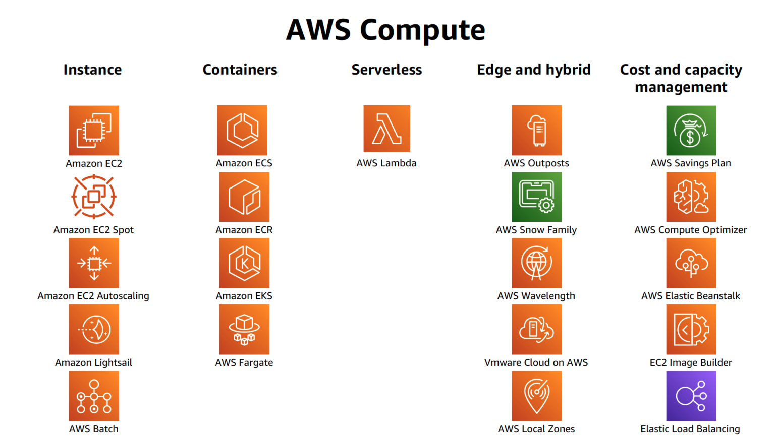
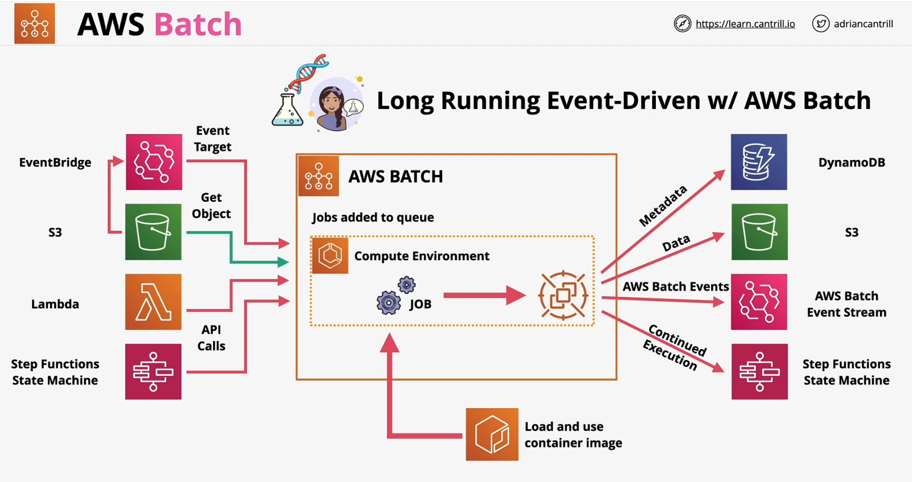
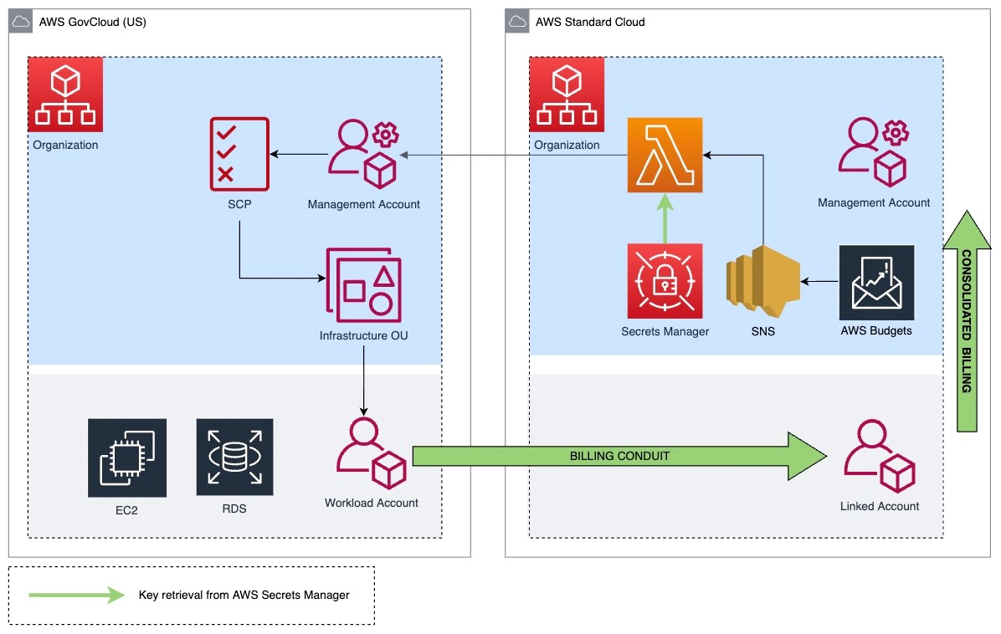
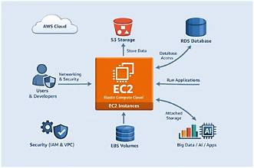
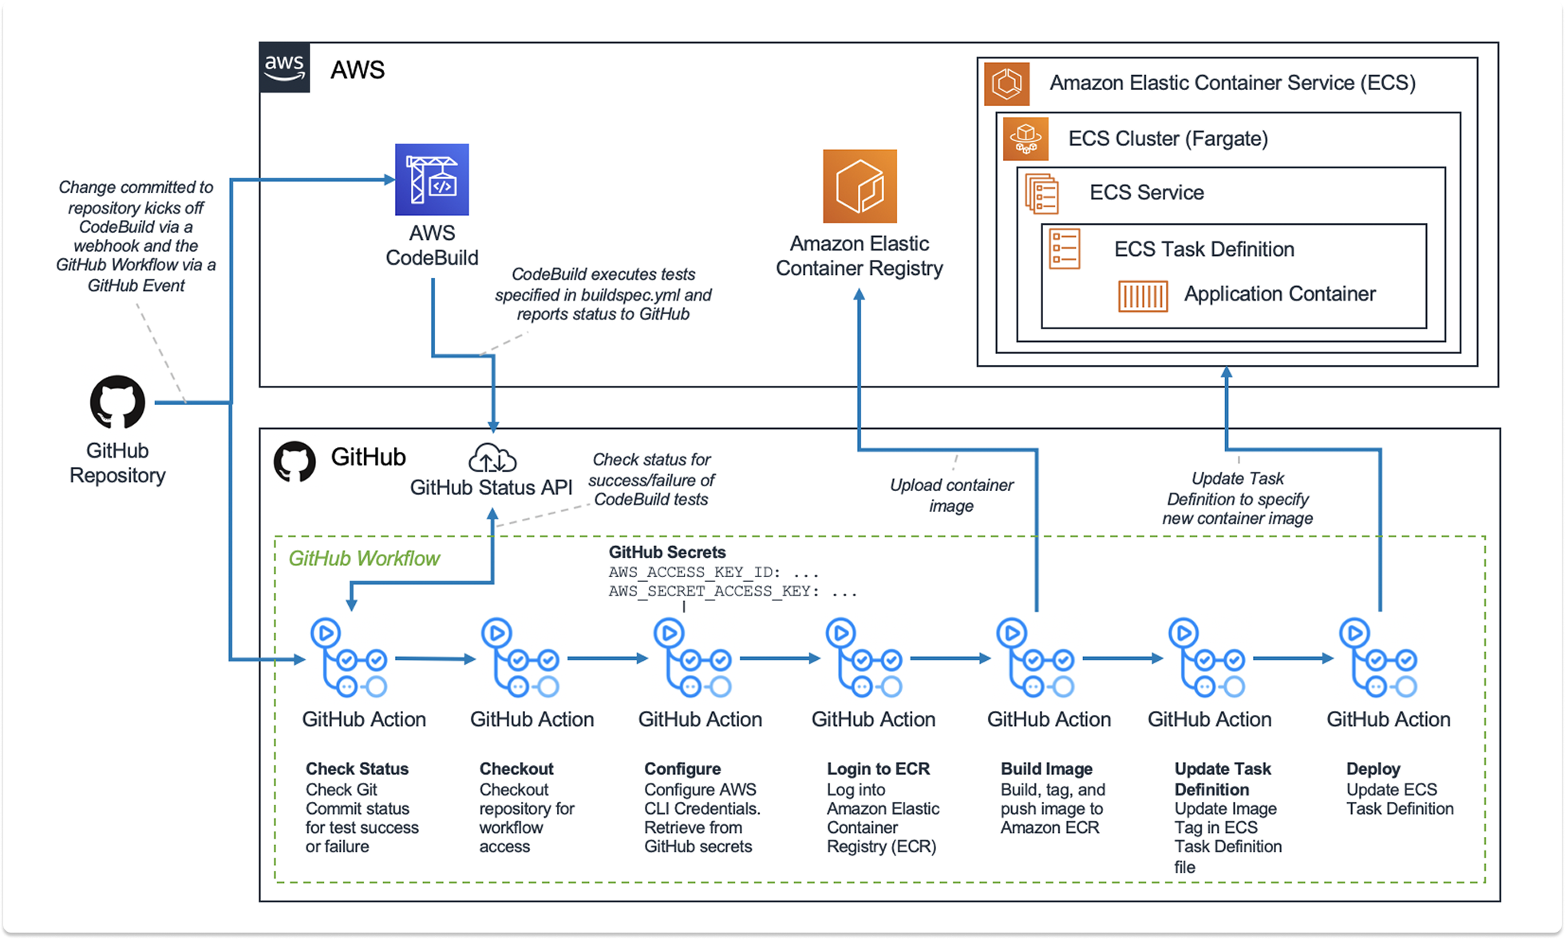
Introduction
https://docs.aws.amazon.com/decision-guides/latest/decision-guides/what-are-decision-guides.html
Notes:
https://github.com/open-guides/og-aws
https://docs.aws.amazon.com/decision-guides/latest/decision-guides/what-are-decision-guides.html

Slide 5
AWS Services
Service Category | Key Services | Description
Compute | EC2, Lambda, ECS | Virtual servers, serverless functions, container orchestration
Storage | S3, EBS, EFS, Glacier | Object storage, block storage, file storage, archival storage
Database | RDS, DynamoDB, ElastiCache | Relational, NoSQL, and in-memory databases
Networking | VPC, Route 53, CloudFront | Virtual networks, DNS, content delivery network
Security | IAM, KMS, WAF, Shield | Identity management, encryption, web application firewall, DDoS protection
Integration | SQS, SNS, API Gateway | Message queues, pub/sub notifications, API management
Monitoring | CloudWatch, CloudTrail | Metrics, logs, events, API activity tracking

Slide 6
Ec2
Amel charoline & Irene M
Amazon Elastic Compute Cloud (EC2) is a web service that provides resizable compute capacity in the cloud. In simpler terms, EC2 allows you to rent virtual servers (called instances) from Amazon's cloud infrastructure, which you can use to run your applications or services. You can choose the instance type based on your needs, whether it's for general-purpose computing, memory-intensive tasks, or high-performance computing.

Slide 7
Ec2
Amel charoline & Irene M
Amazon Elastic Compute Cloud (EC2) is a web service that provides resizable compute capacity in the cloud. In simpler terms, EC2 allows you to rent virtual servers (called instances) from Amazon's cloud infrastructure, which you can use to run your applications or services. You can choose the instance type based on your needs, whether it's for general-purpose computing, memory-intensive tasks, or high-performance computing.

Slide 8
How to create
Amel charoline & Irene M
EC2 Machine

Slide 9
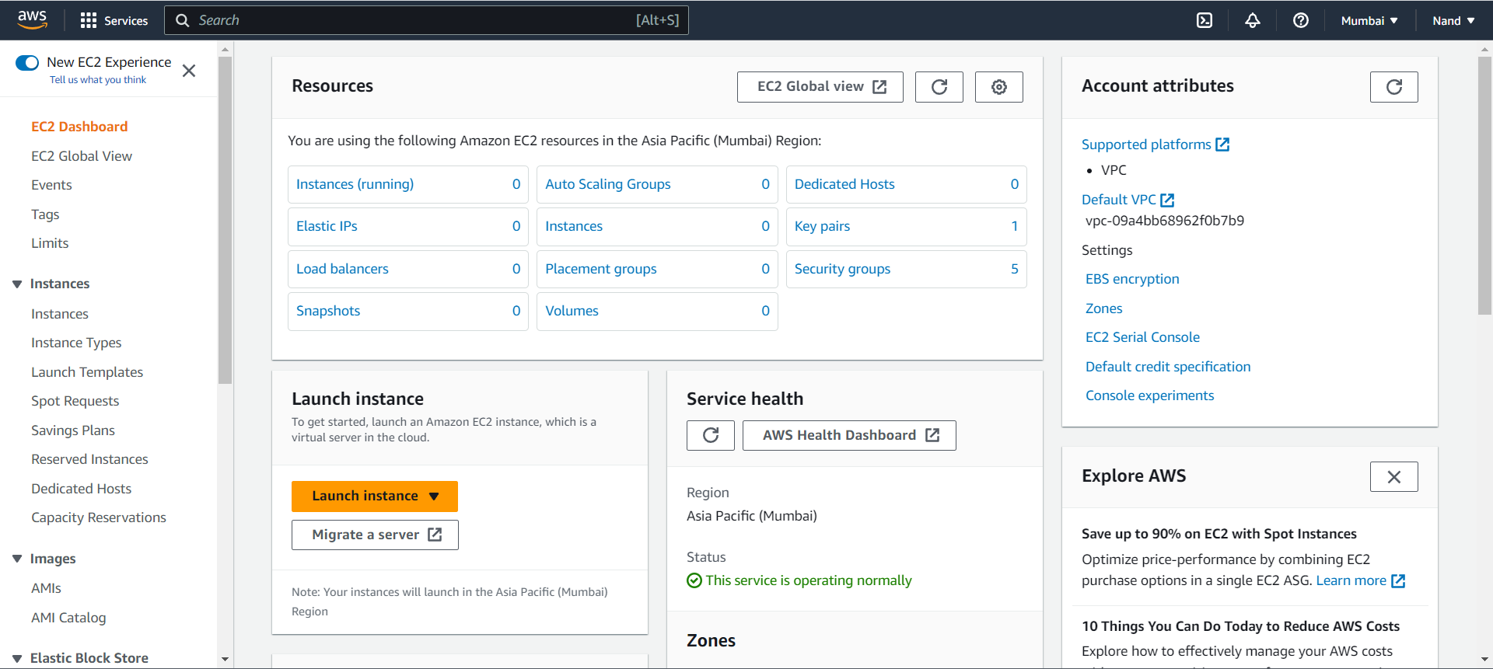
Ec2 Dashboard
Amel charoline & Irene M

Slide 10
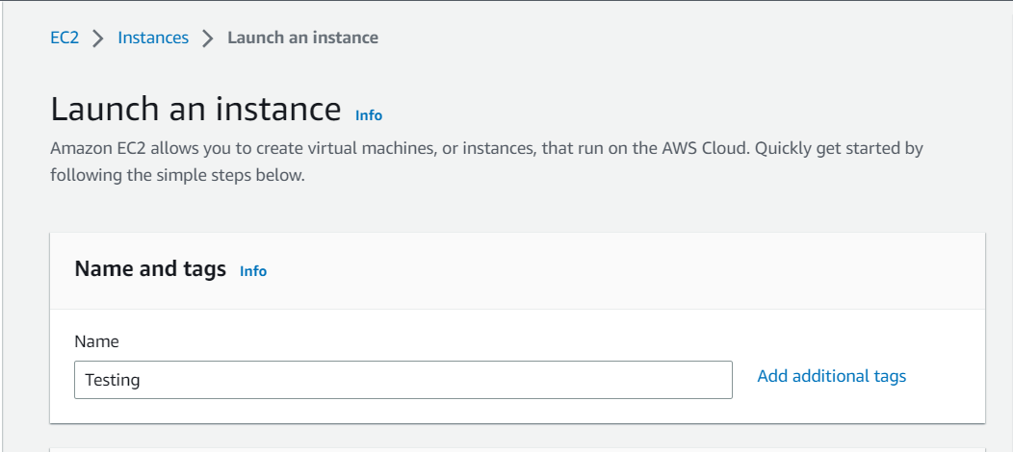
Naming of Instance
Amel charoline & Irene M

Slide 11
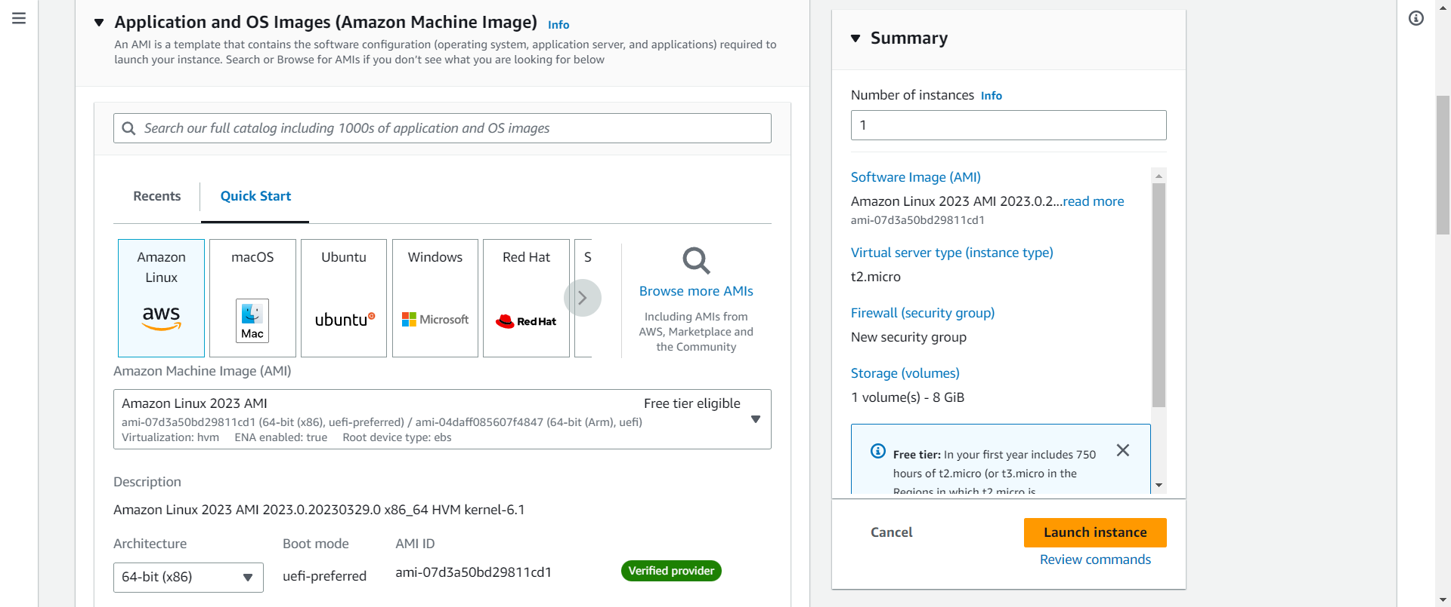
OS Types
Amel charoline & Irene M

Slide 12
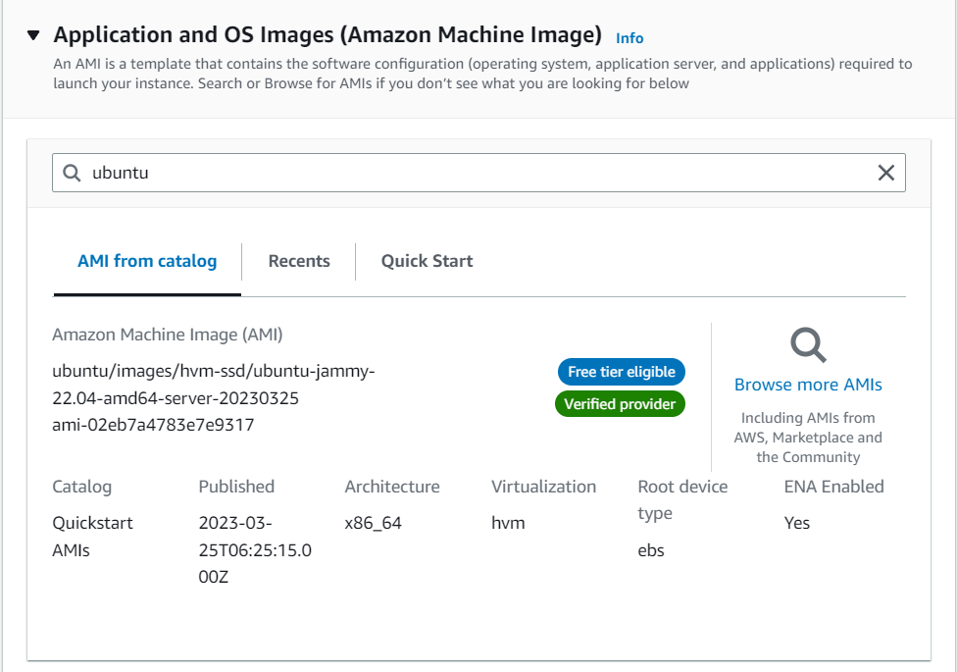
Os Types
Amel charoline & Irene M

Slide 13
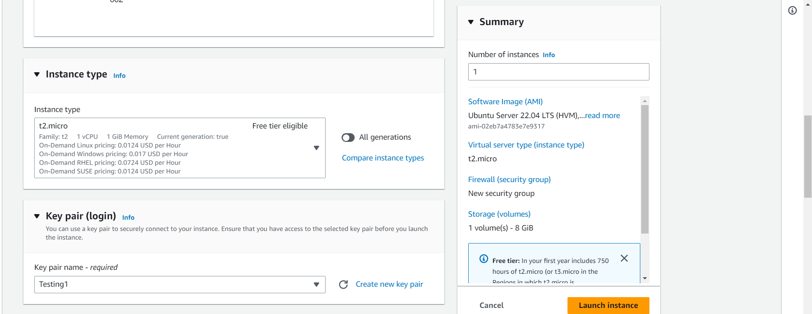
Instance Types
Amel charoline & Irene M

Slide 14
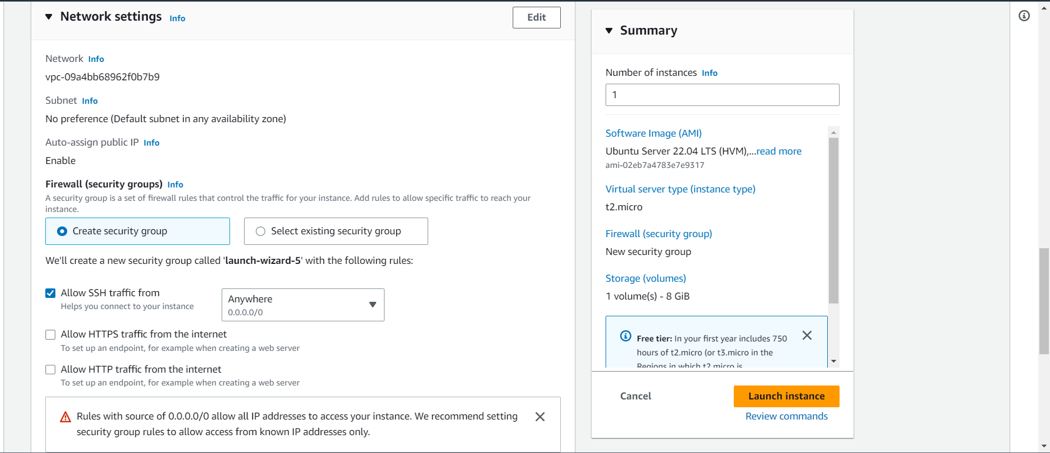
Network Setting for traffic
Amel charoline & Irene M

Slide 15
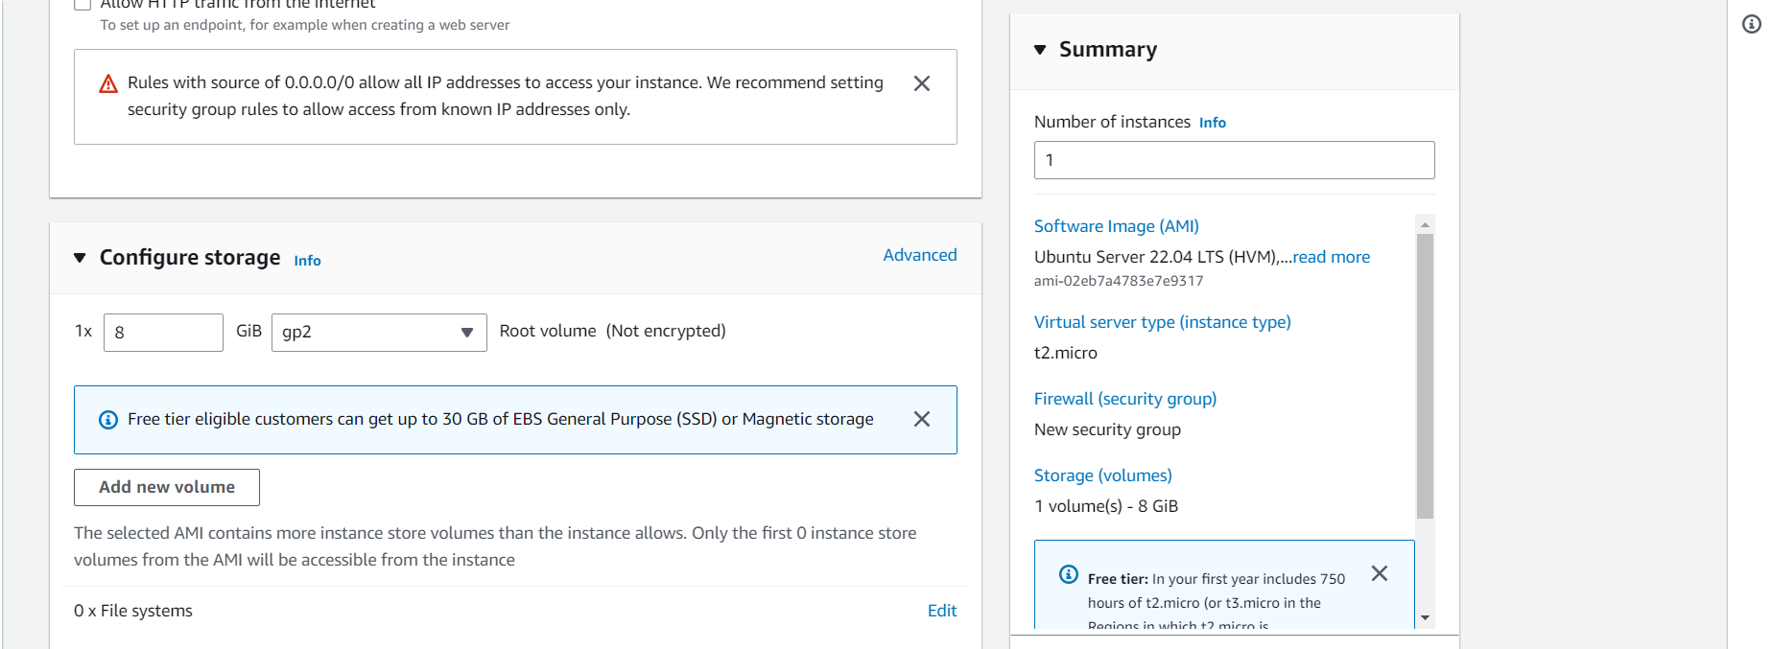
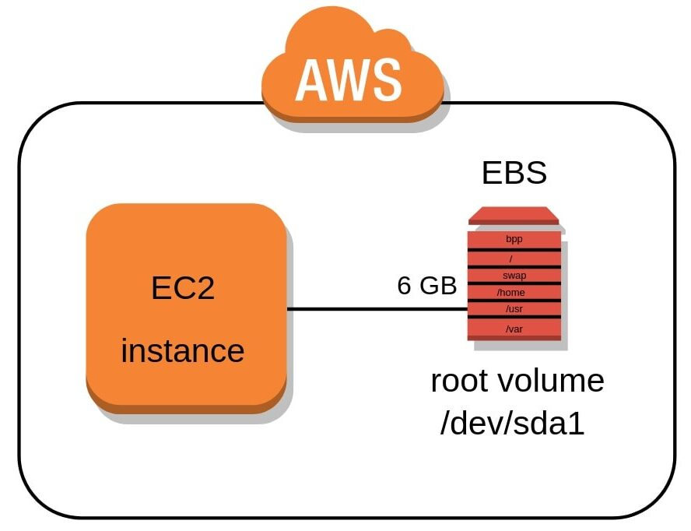
Storage to install OS on EC2
Amel charoline & Irene M

Slide 16
Amel charoline & Irene M

Slide 17
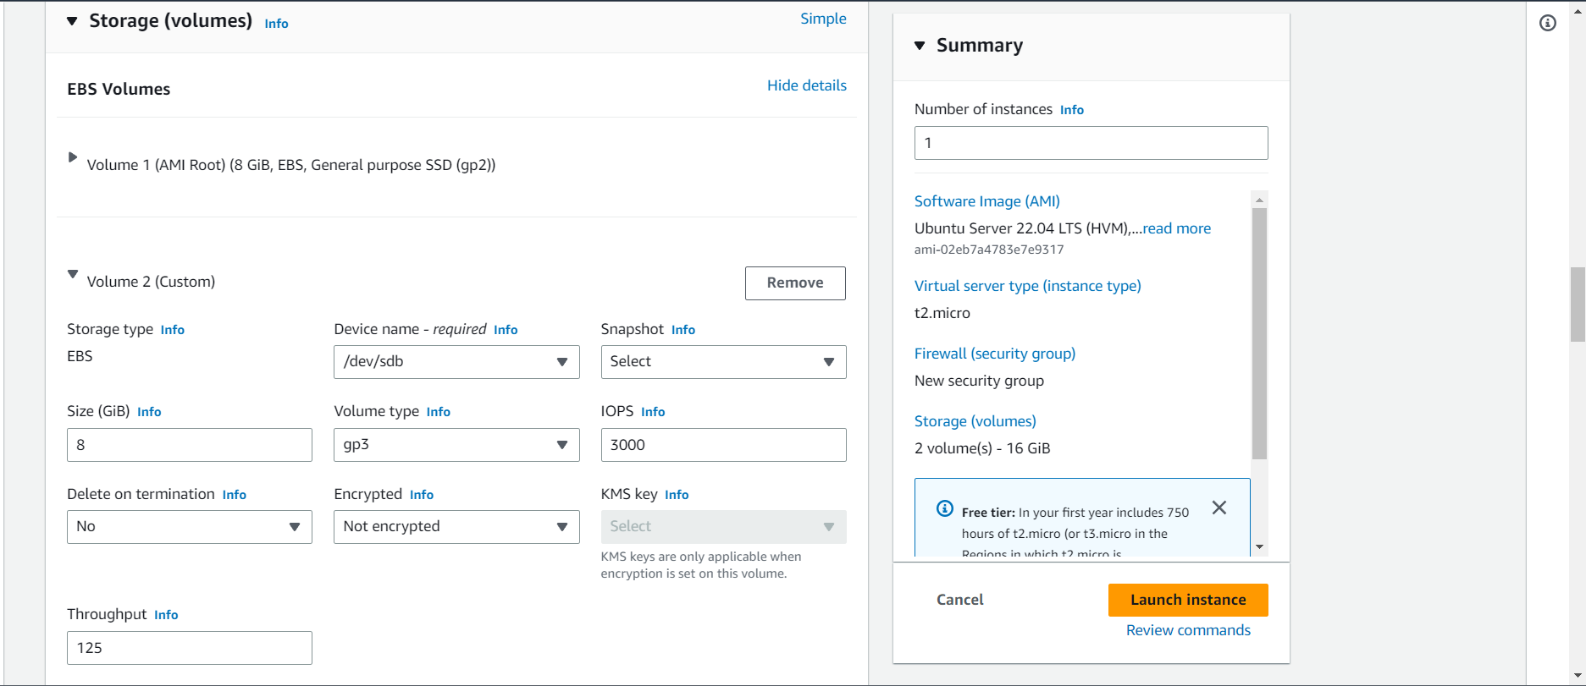
Advance volume settings
Amel charoline & Irene M

Slide 18
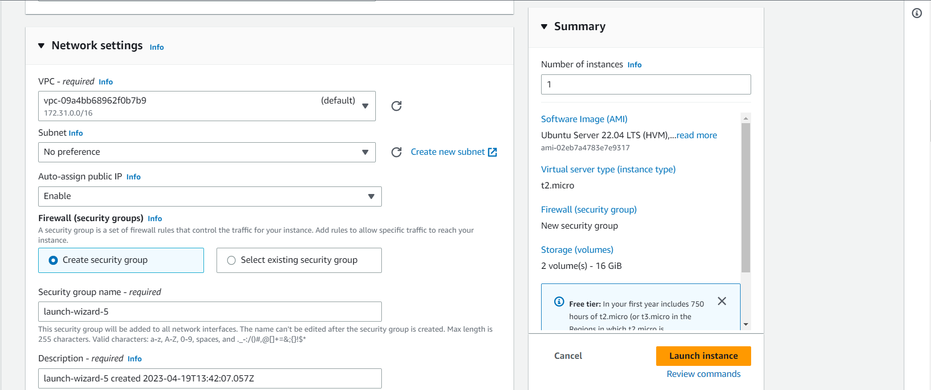
Advance network settings Virtual Private Cloud
Amel charoline & Irene M

Slide 19
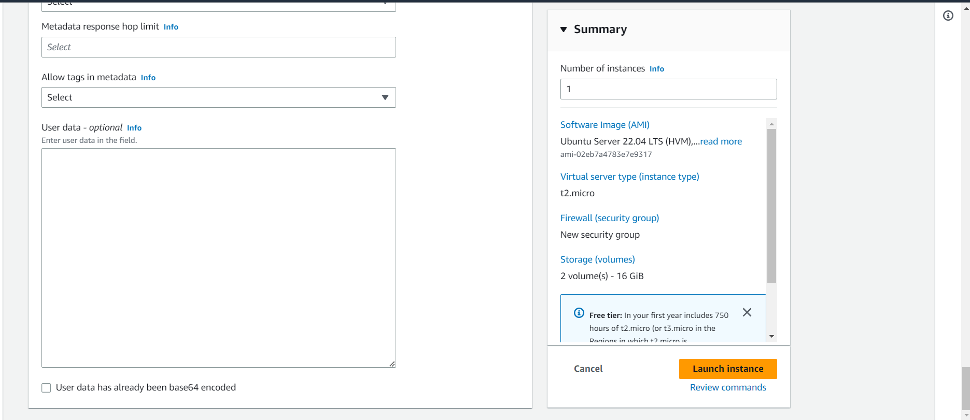
Advance pre-configuration
Amel charoline & Irene M

Slide 20
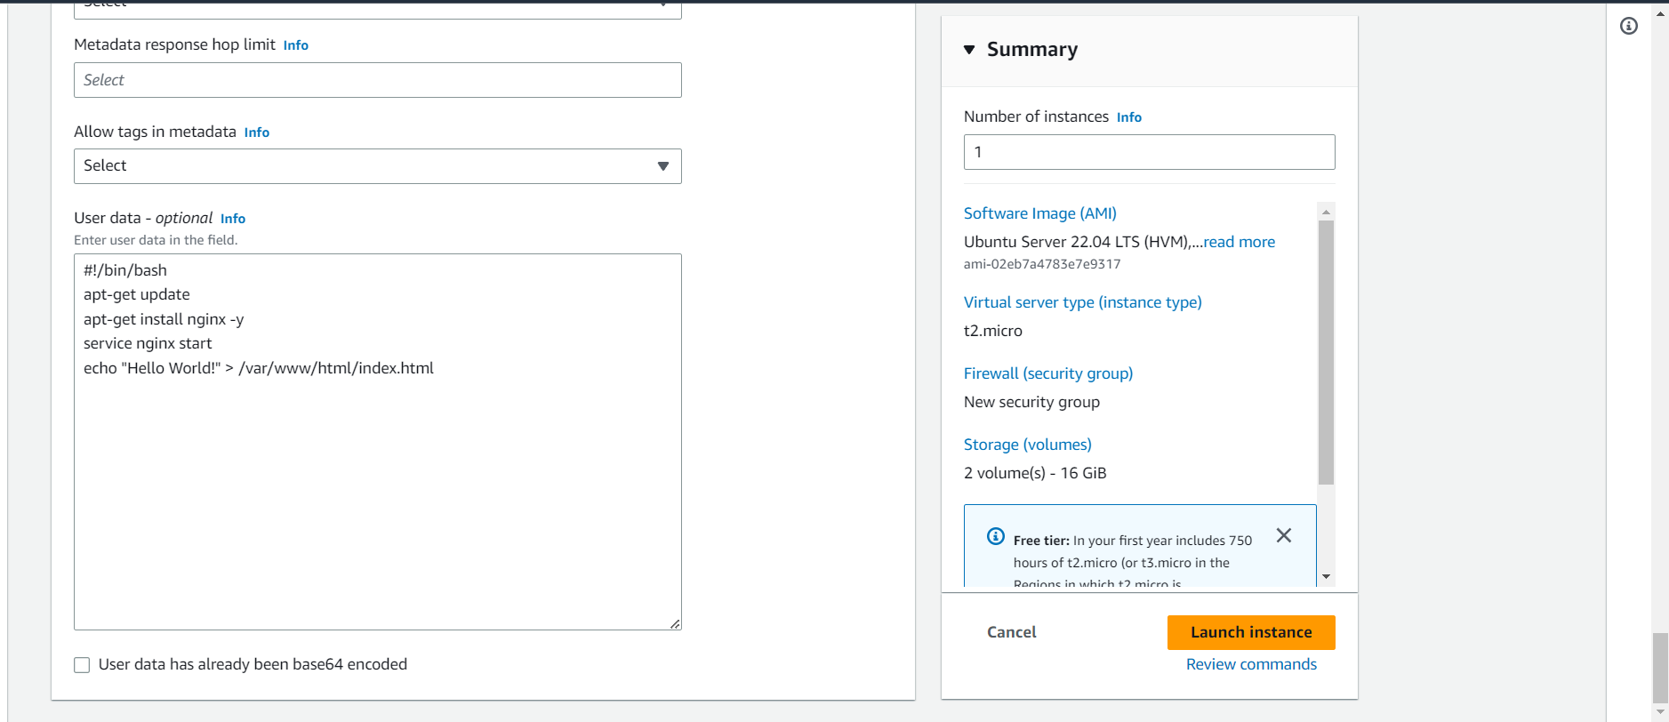
Bash Script(as Root user be careful)
Amel charoline & Irene M

Slide 21
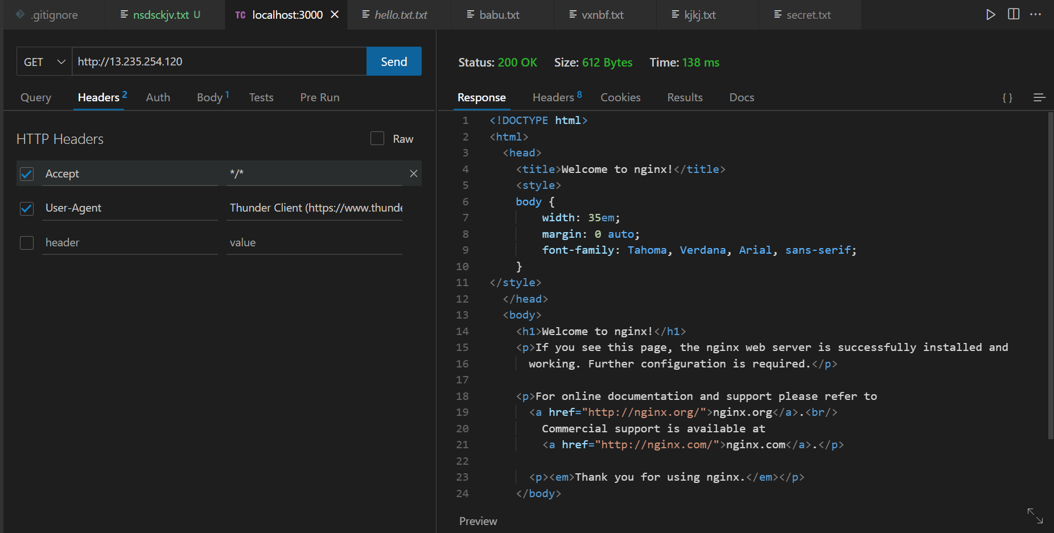
Response from Ec2
Amel charoline & Irene M

Slide 22
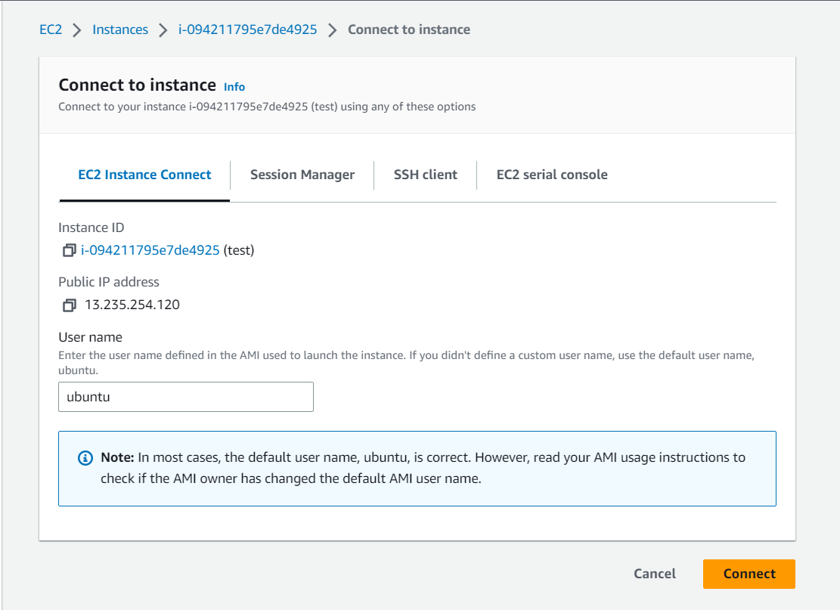
Ec2 connection method
Amel charoline & Irene M

Slide 23
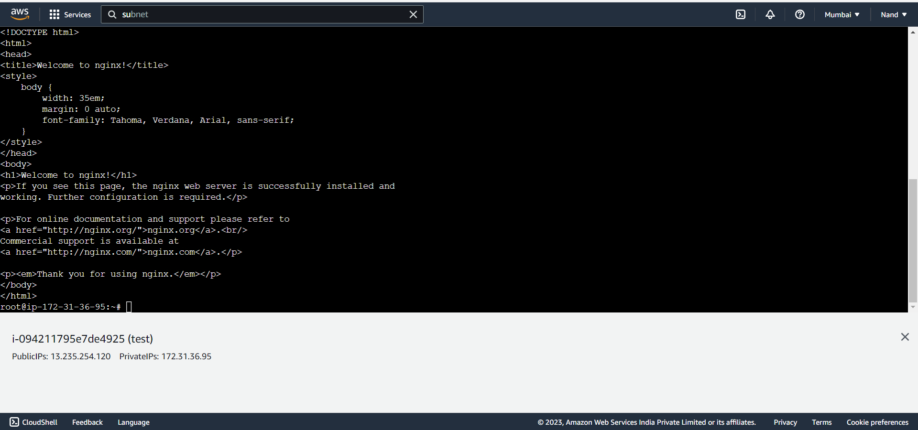
SSH connection from AWS Web
Amel charoline & Irene M

Slide 24
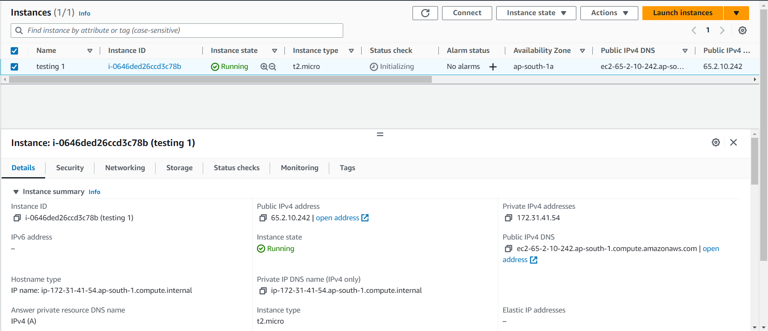
IP Address
Amel charoline & Irene M

Slide 25
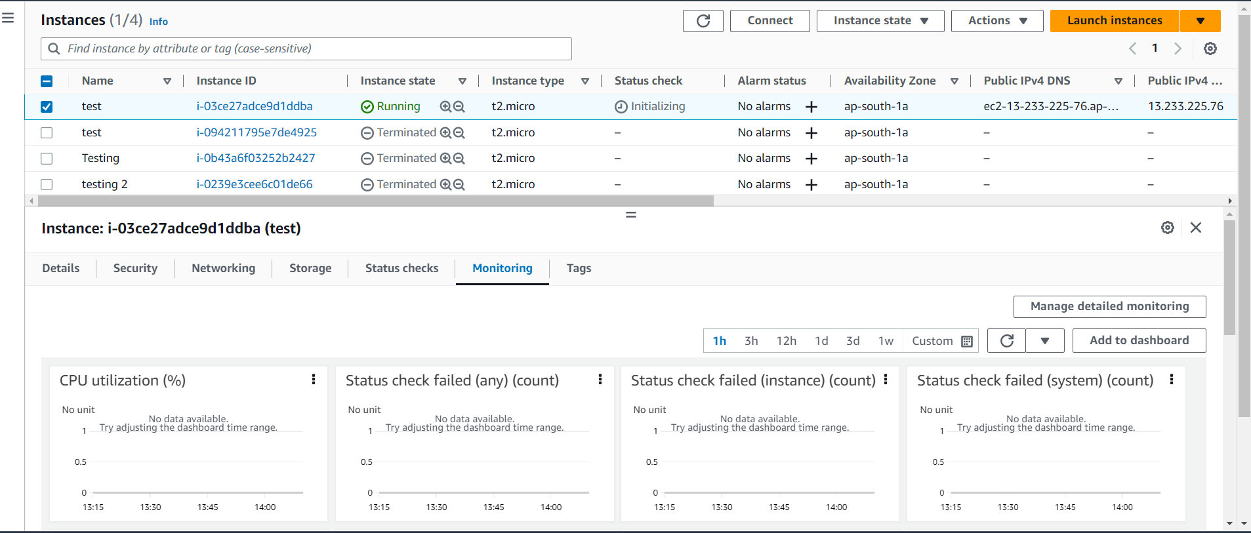
Resource Monitor
Amel charoline & Irene M

Slide 26
Amel charoline & Irene M

Slide 27
Amel charoline & Irene M

Slide 28
Amel charoline & Irene M

Slide 29
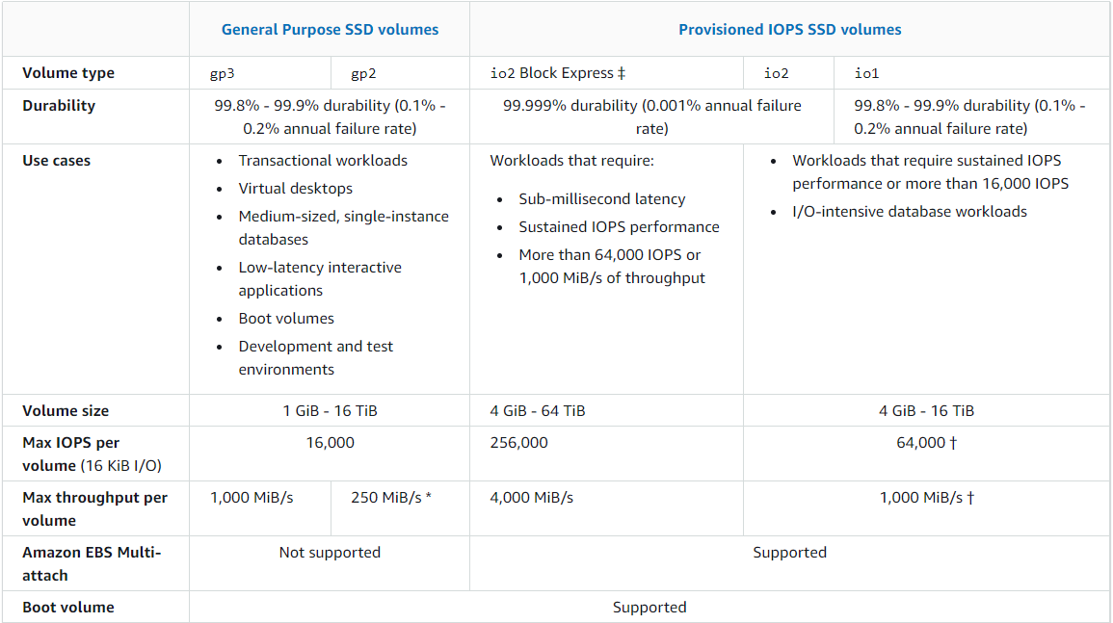
EBS types
Amel charoline & Irene M

Slide 30
Amel charoline & Irene M
Security Practice

Slide 31
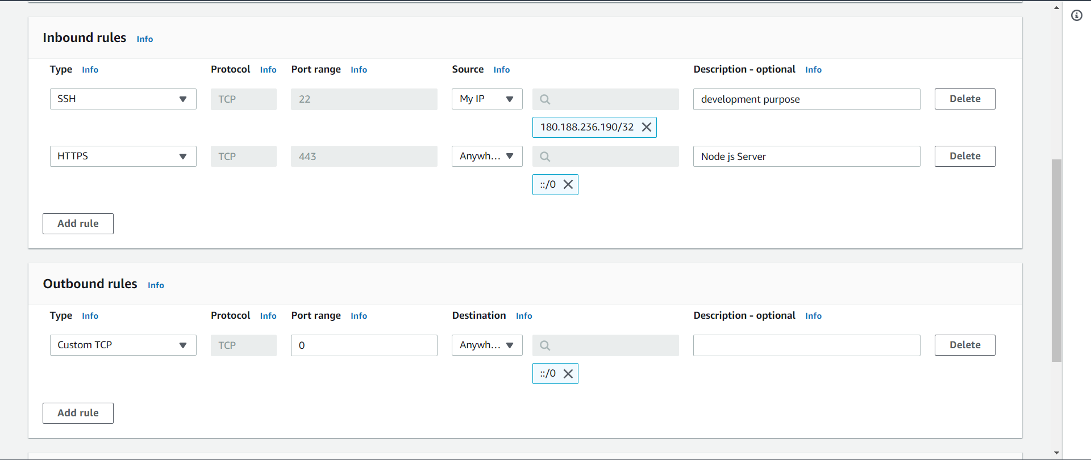
Amel charoline & Irene M

Slide 32
SECURITY GROUPS VISUAL VIEW
Amel charoline & Irene M

Slide 33
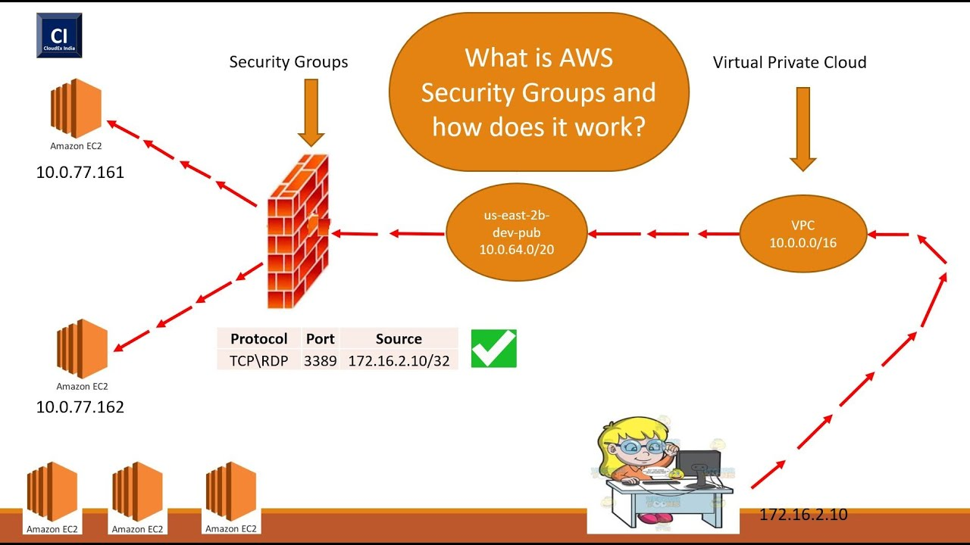
Amel charoline & Irene M

Slide 34
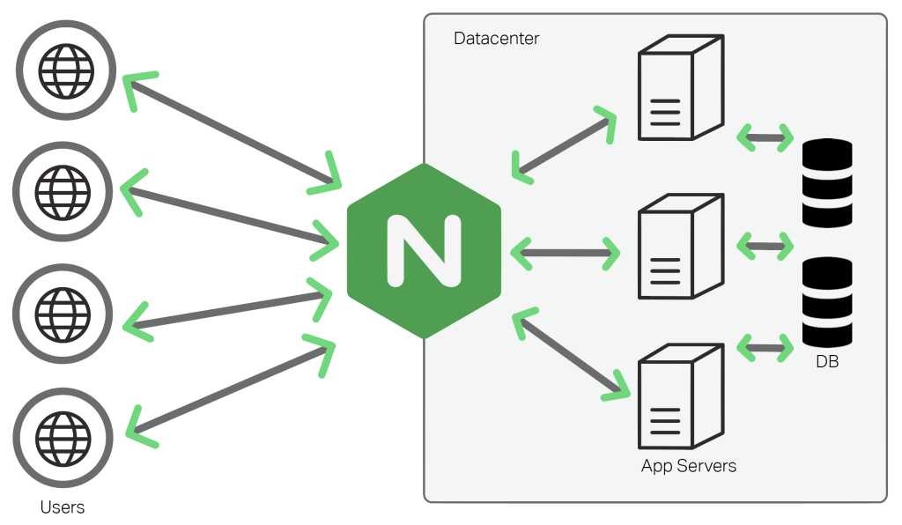
Amel charoline & Irene M

Slide 35
Amel charoline & Irene M

Slide 36
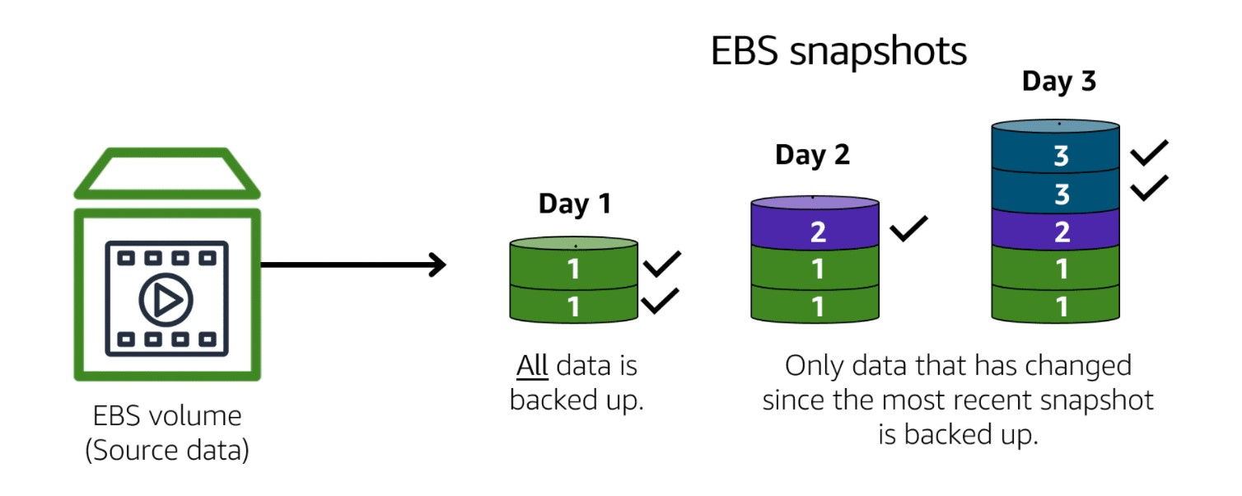
Amel charoline & Irene M

Slide 37
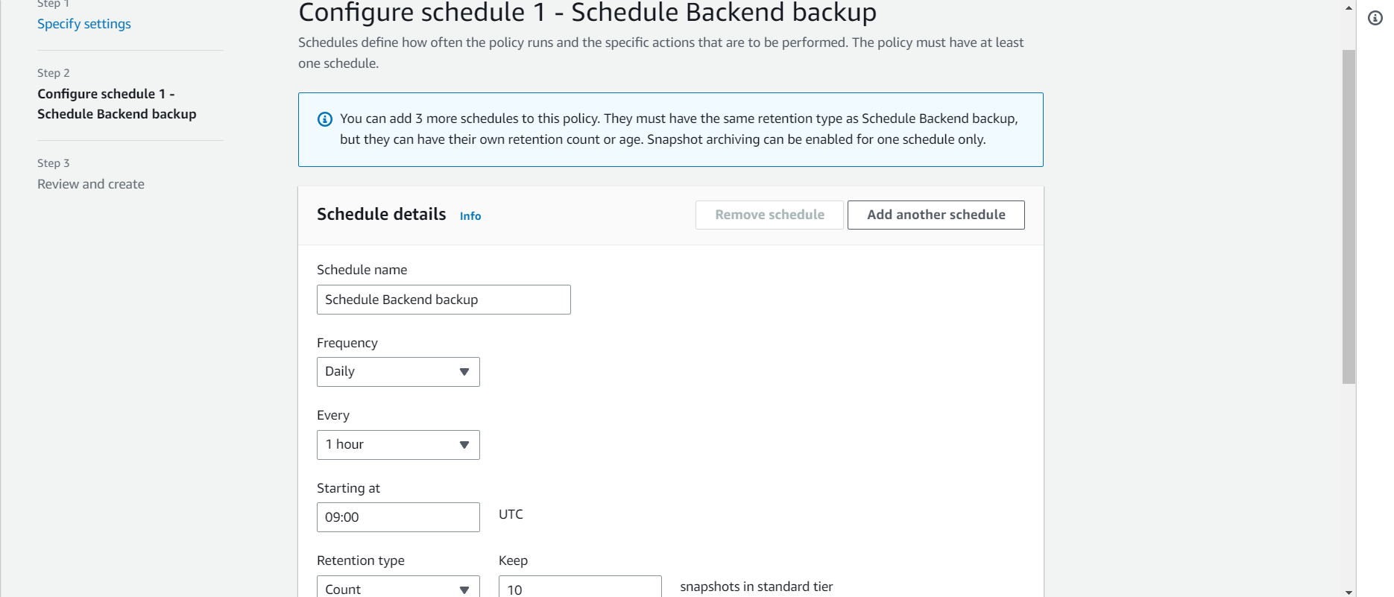
Amel charoline & Irene M

Slide 38
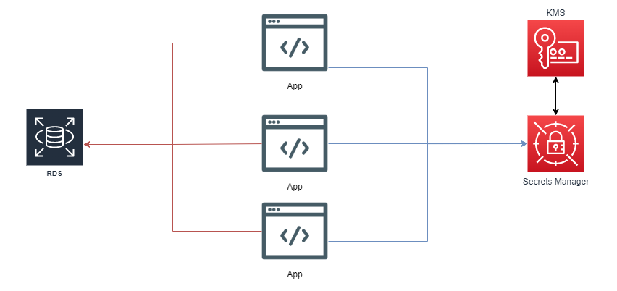
Amel charoline & Irene M

Slide 39
Amel charoline & Irene M
Price Optimization

Slide 40
Amel charoline & Irene M

Slide 41
Amel charoline & Irene M

Slide 42
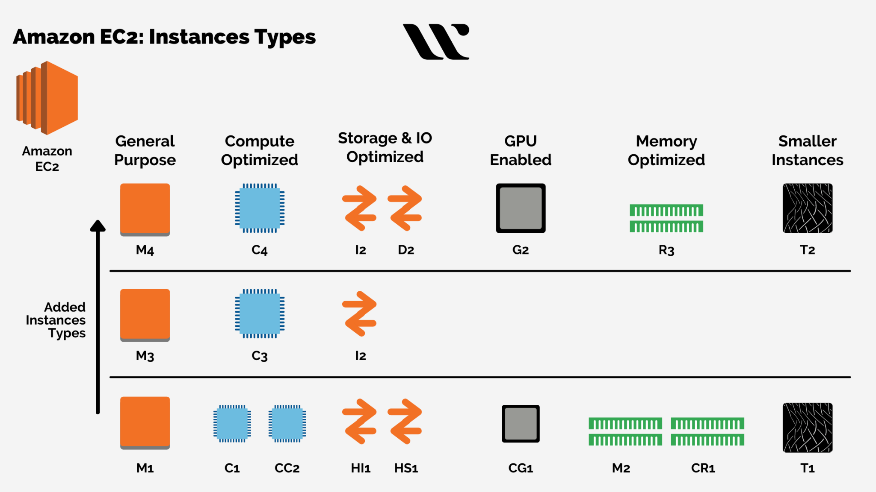
Amel charoline & Irene M

Slide 43
Amel charoline & Irene M

Slide 44
Amel charoline & Irene M

Slide 45
Amel charoline & Irene M

Slide 46
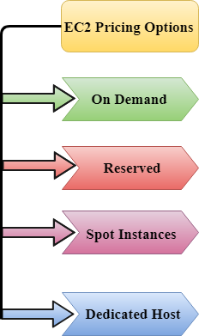
Amel charoline & Irene M

Slide 47
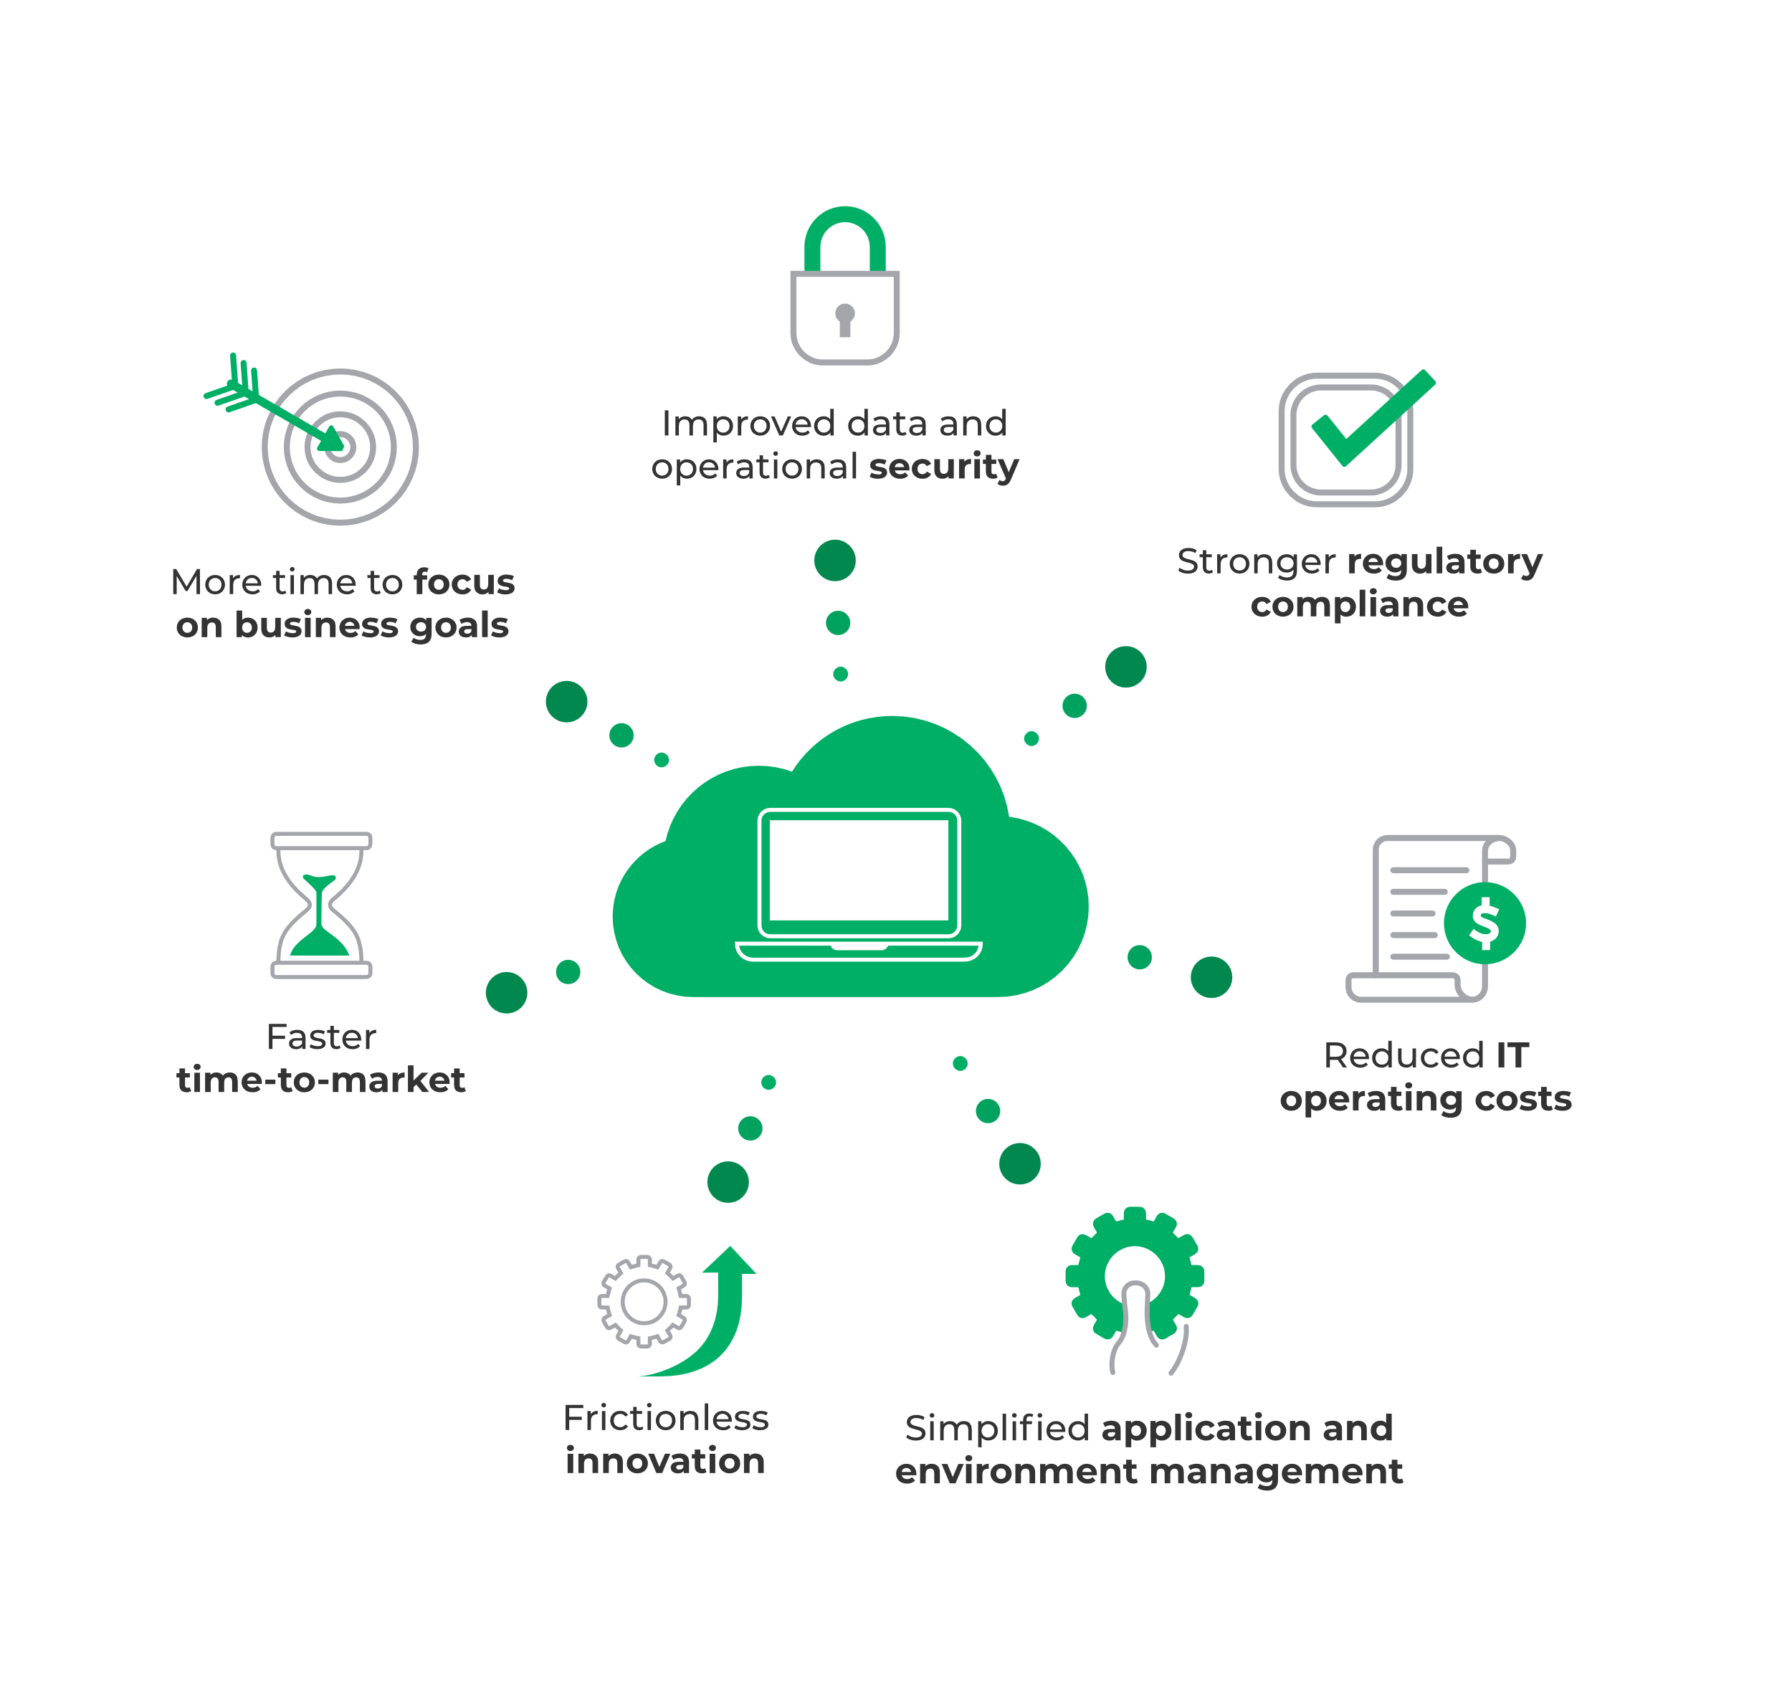
AWS Managed Services
Amel charoline & Irene M

Slide 48
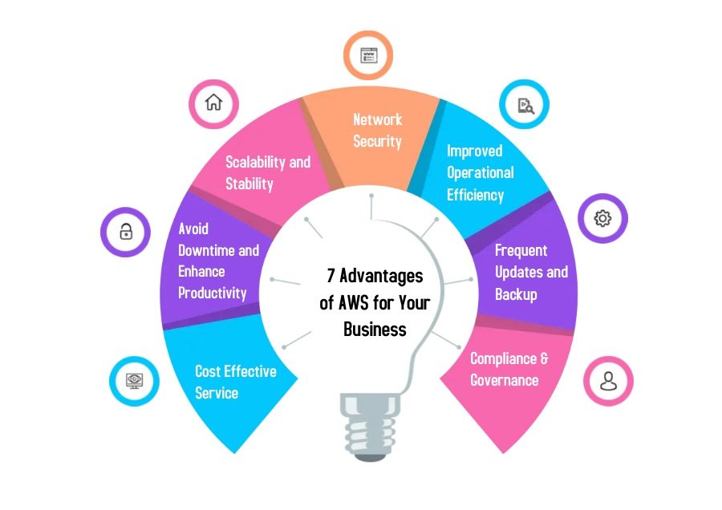
AWS Managed Services Benefit
Amel charoline & Irene M

Slide 49





Development & HOST
Amel charoline & Irene M
Architecture& ci-cd setup
Development
Testing
Git-hub
LAUNCH
First define the architecture of project may be monolithic or micro-service
Now choose any asynchronous framework and do development
Now test on the local system and build the production file
Now push development build file on the git repo
From git-hub you can set direct AWS pipeline to deploy production server

Slide 50
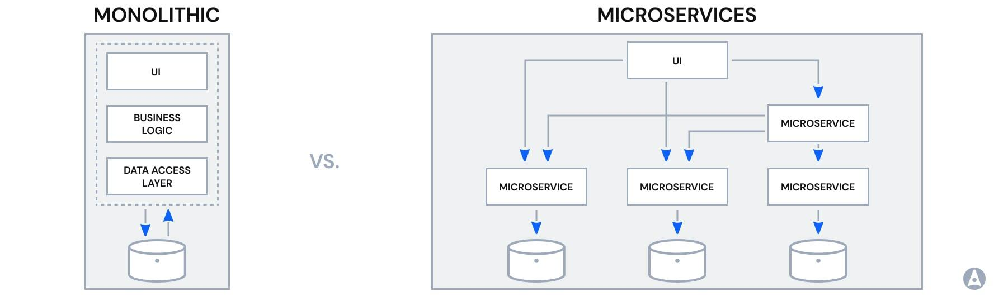
Application architecture
Amel charoline & Irene M

Slide 51
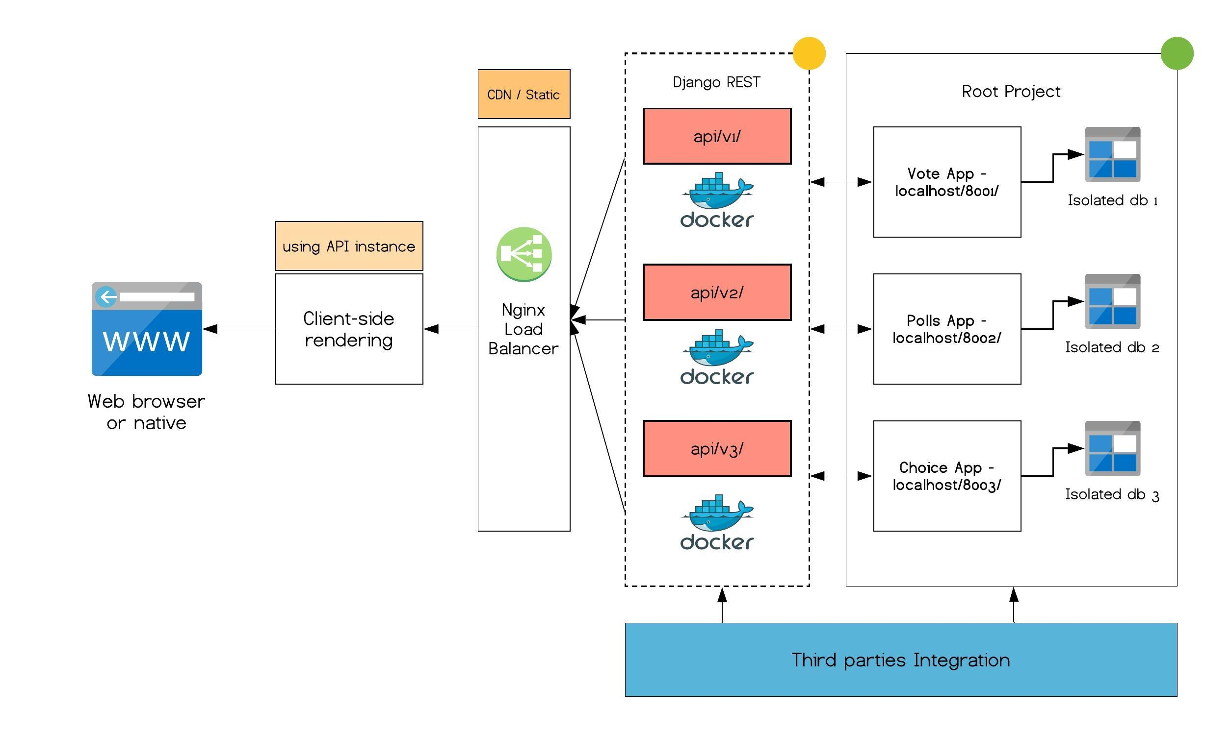
Example
Amel charoline & Irene M

Slide 52
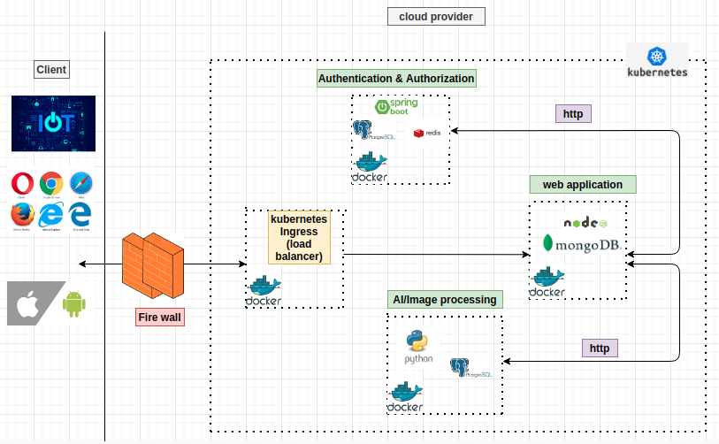
Example
Amel charoline & Irene M

Slide 53
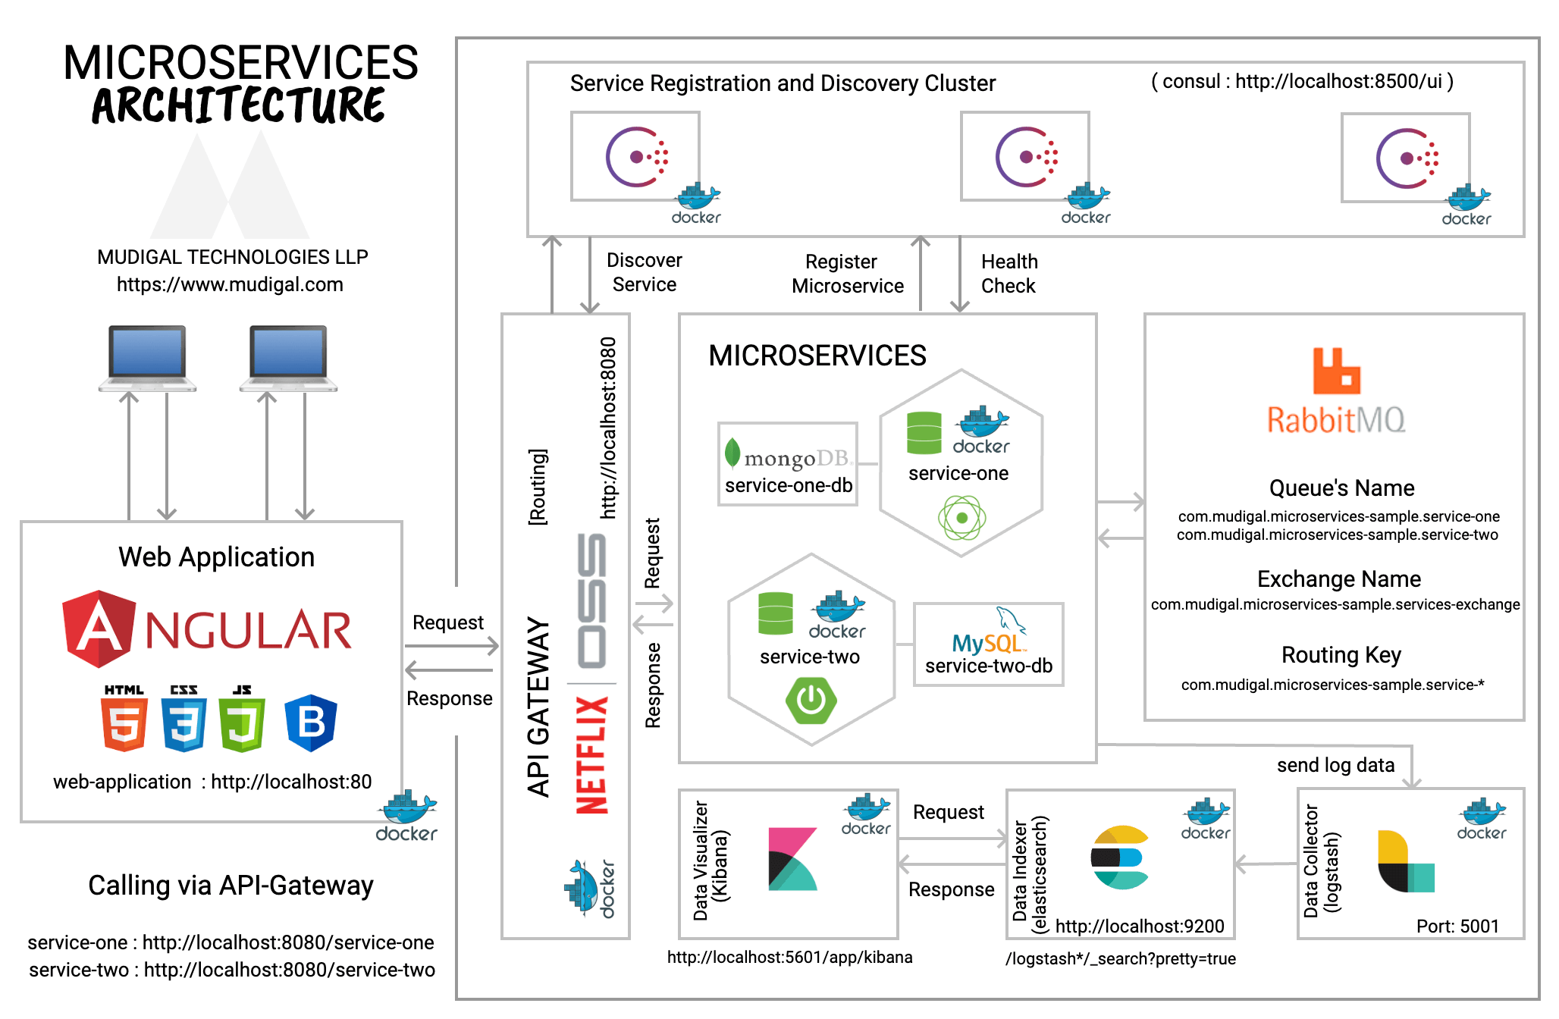
Amel charoline & Irene M

Slide 54
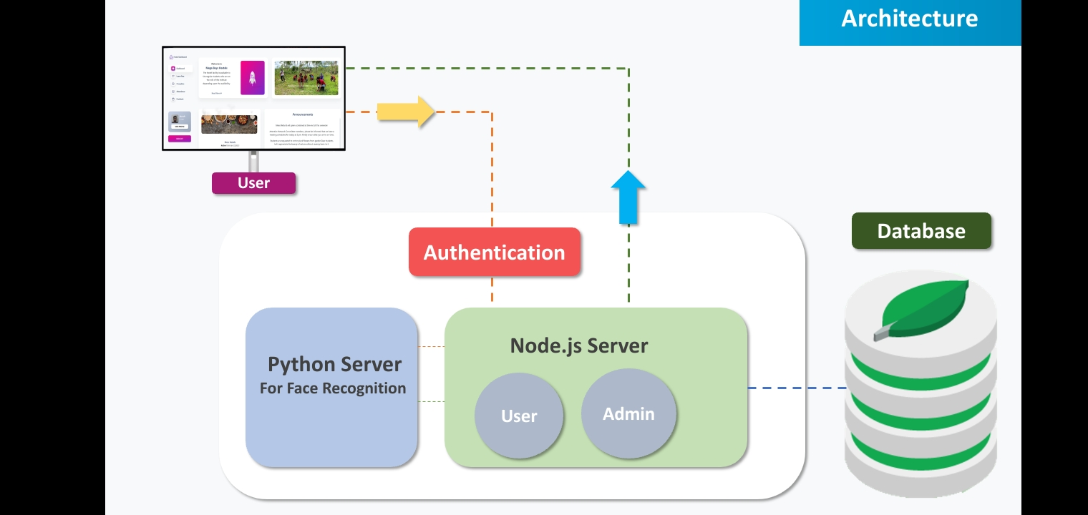
Amel charoline & Irene M

Slide 55
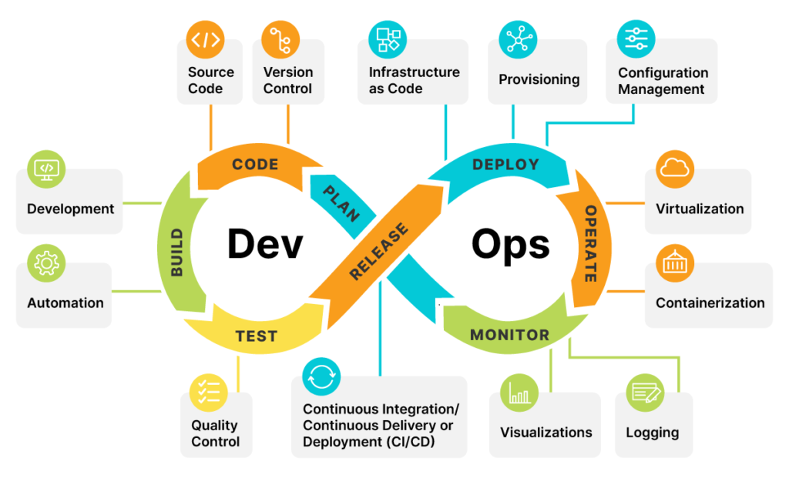
Work Flow in DevOps
Amel charoline & Irene M

Slide 56
Road map for devops
Amel charoline & Irene M
Medium level
Advance level
Linux
Networking
Security
CI/CD
AWS
Infrastructure as code
Programming
Containers
Kubernetes

Slide 57
THANK YOU
Amel charoline & Irene M
Amel Online & Irene magdalena
https://github.com/siagianp
https://www.youtube.com/@AmelOline/videos
https://github.com/amelcharolinesgn2/Cloud-Infrastructures
https://github.com/amelcharolinesgn2/ClouD-Infrastructure-SISKA-2025
https://github.com/amelcharolinesgn2/CCNA1
https://github.com/amelcharolinesgn2/CCNA2
https://github.com/amelcharolinesgn2/AWS Certificate

